Slide 1
Street light detection

Slide 2
Results update
Understood the repo.
Updated the val.py code for ensuring that we take the ground truth for the band and the predictions also for the band. Calculated mAP50 for this condition.

Slide 3
Active Learning for annotations
Understood about active learning for object detection using the following links:
https://medium.com/@hardik.dave/active-learning-sampling-strategies-f8d8ac7037c8
https://kili-technology.com/blog/active-learning-for-object-detection
https://towardsdatascience.com/active-learning-for-an-efficient-data-annotation-strategy-4d007c5d7ed1

Slide 4
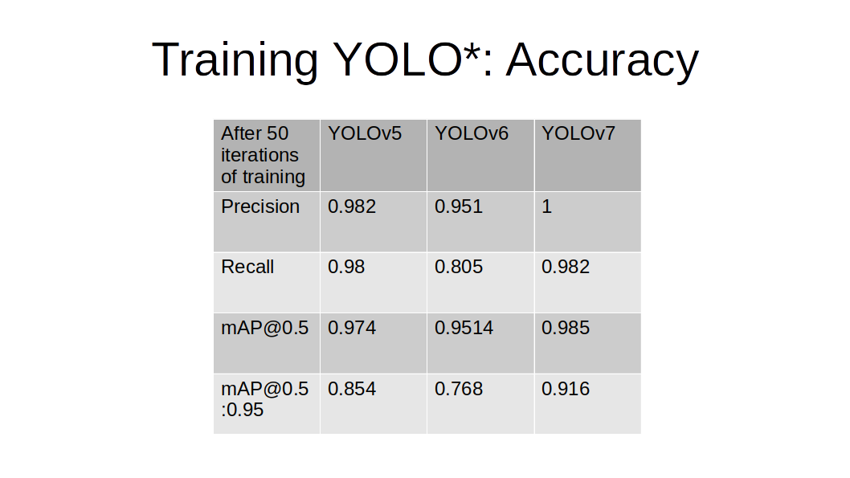
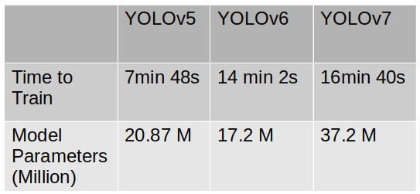
YoloV5 vs YoloV6 vs YoloV7
Dataset is the Anki vector dataset which is a custom open source dataset made publicly available at Roboflow.
Link: https://app.roboflow.com/vectorstuff/vectorcompletedataset/8
Training Time
Yolov7 > Yolov6 > Yolov5
Yolov7 > Yolov5 > Yolov6

Slide 5
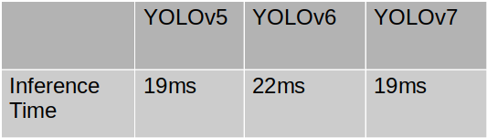
Yolov6 > Yolov7 >= Yolov5
So for accuracy we have Yolov7 as best followed by Yolov5 then Yolov6.
For training time we have minimum time taken by Yolov5 followed by Yolov6 then Yolov7
For inference time we have minimum time taken by Yolov5 followed by Yolov6 then Yolov7
So I believe we must use YoloV7 if we have high quality computational resources or if dataset is small else YoloV5 . YoloV6 must not be used.

Slide 6
Small Object Tracking
Work in progress

Slide 7
LOST (Localizing Objects with Self-Supervised Transformers)
Paper: https://arxiv.org/abs/2109.14279
Approach: Use the activation features of a vision transformer pre-trained in a self-supervised manner. Does not require any external object proposal nor any exploration of the image collection and it operates on a single image.
Our usage: Since LOST is responsible for localizing the objects in the image we get the output as the bounding box on the object. Can be extended for streetlight as objects as custom training.

Slide 8
Super point
Paper: https://arxiv.org/abs/1712.07629
Approach: Fully-convolutional model operates on full-sized images and jointly computes pixel-level interest point locations and associated descriptors in one forward pass. Introduction of Homographic Adaptation, a multi-scale, multi-homography approach for boosting interest point detection repeatability and performing cross-domain adaptation (e.g., synthetic-to-real)
Usage:

Slide 9
SHOT (Source Hypothesis Transfer)
Paper: http://proceedings.mlr.press/v119/liang20a.html
Approach: A classification model available trained over, instead of accessing to, the source data. To effectively utilize the source model for adaptation, SHOT learns the feature extraction module for the target domain by fitting the target data features to the frozen source classification module. Specifically, SHOT exploits both information maximization and self-supervised learning for the feature extraction module learning to ensure the target features are implicitly aligned with the features of unseen source data via the same hypothesis
Usage: Since we have source data no need to use this method.

